Slide 1
MCMC Convergence and troubleshooting

Slide 2
Failed initialization

Slide 3
Failed initialization
Check initial values
Check for incompatible priors
Increase number of initialization attempts
Talk to the developers / BEAST2 support group

Slide 4
MCMC theory guarantees convergence to the posterior distribution => but not when ! => how do we know when our inference has converged ?
Convergence

Slide 5
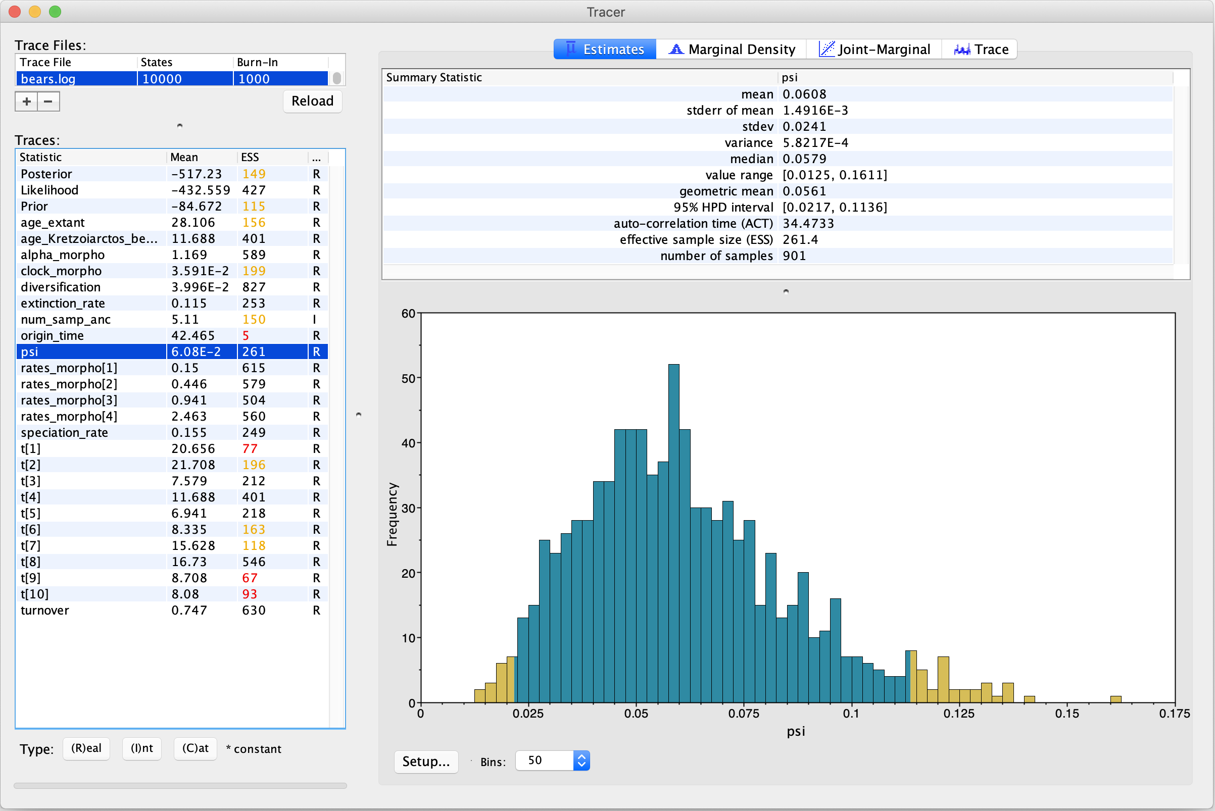
Tracer

Slide 6
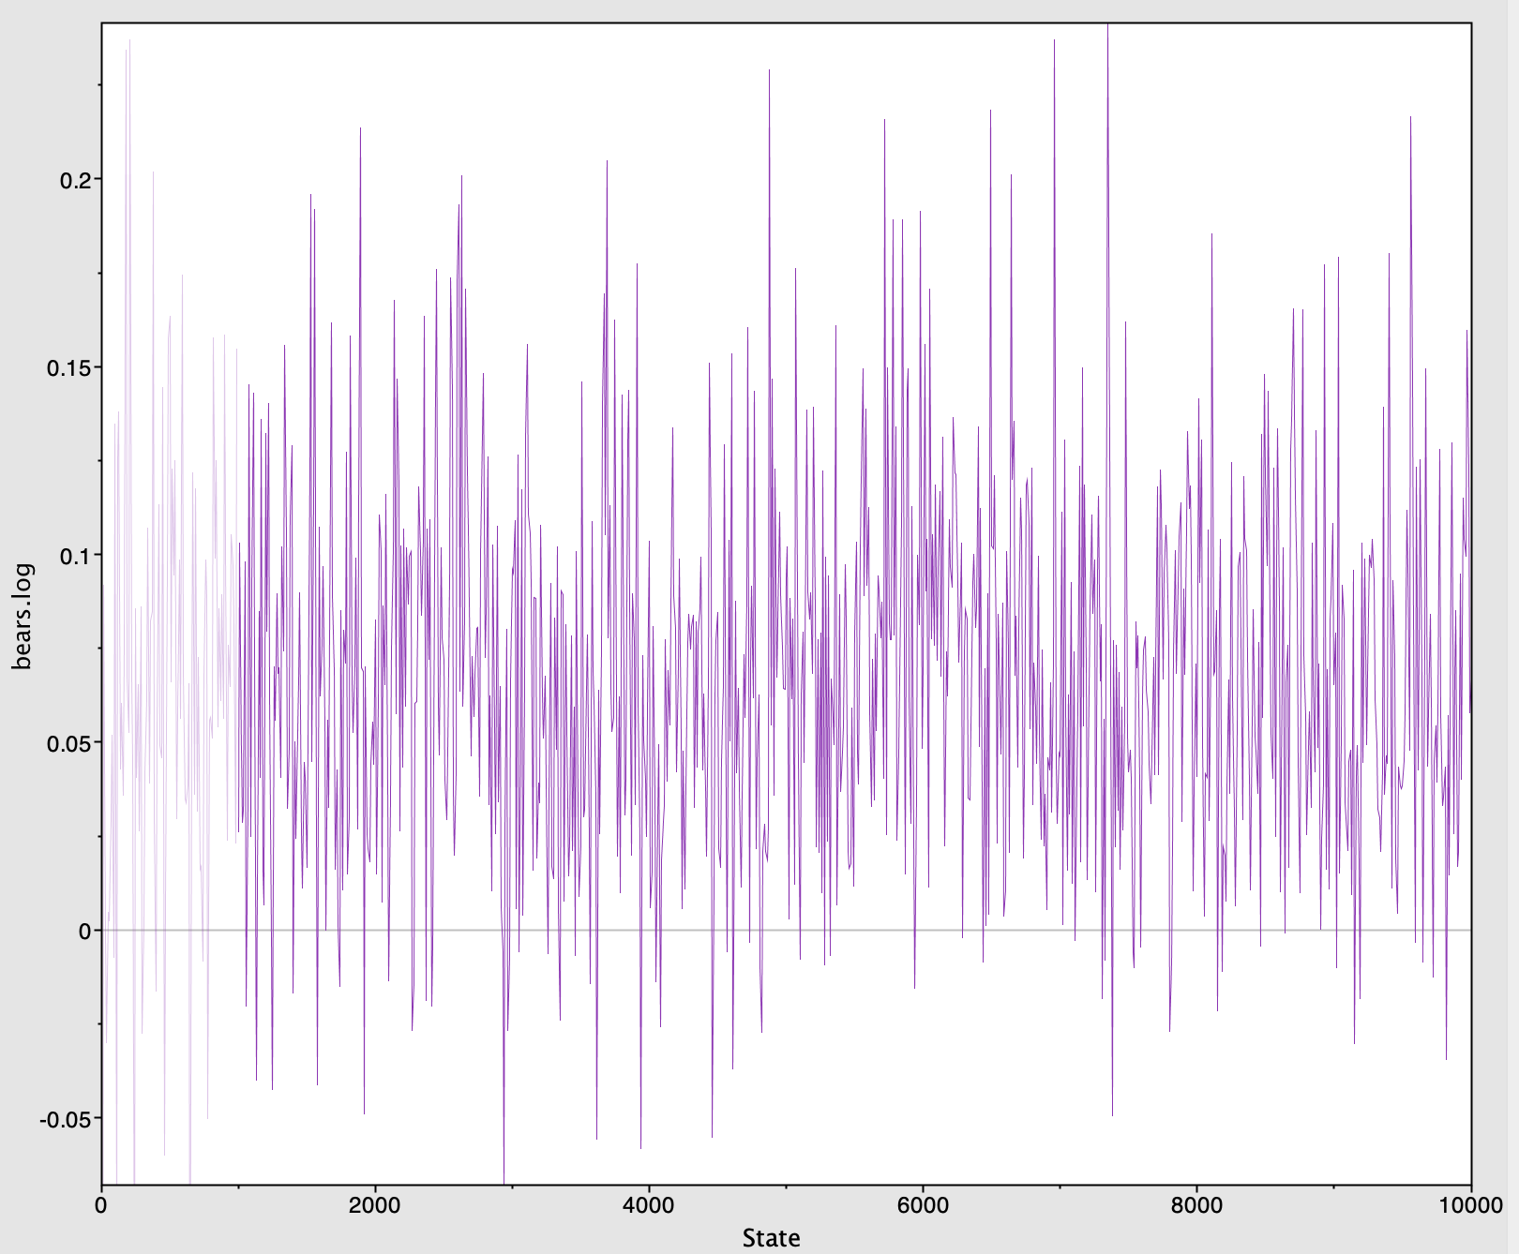
Tracer

Slide 7
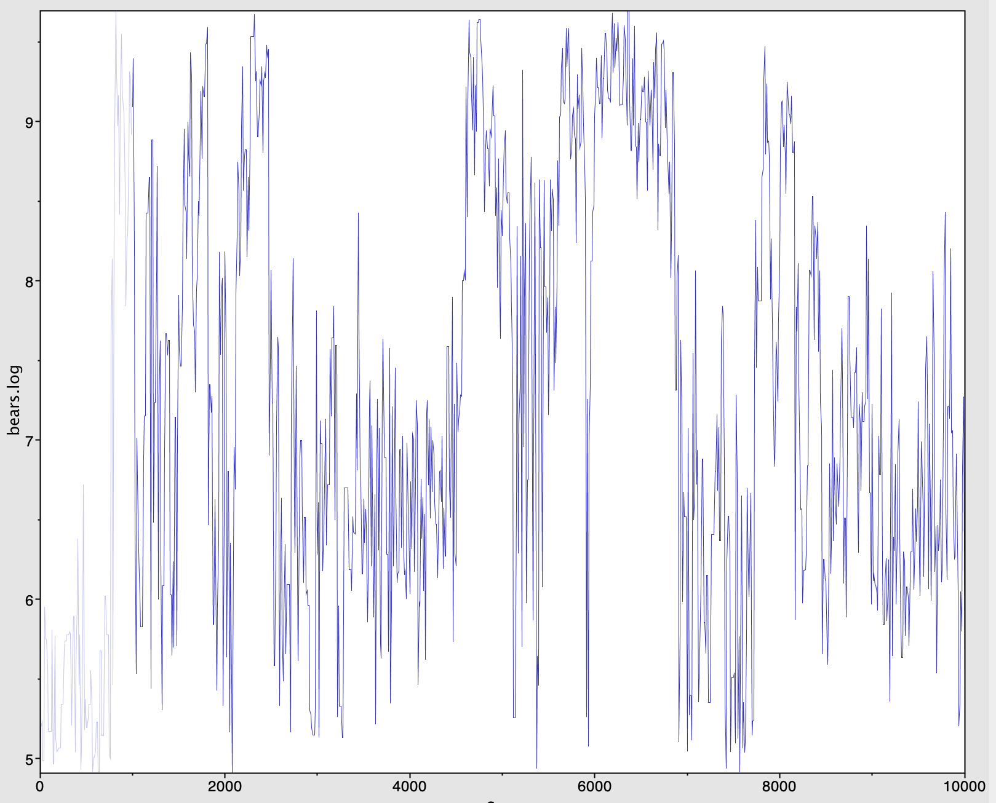
Tracer

Slide 8
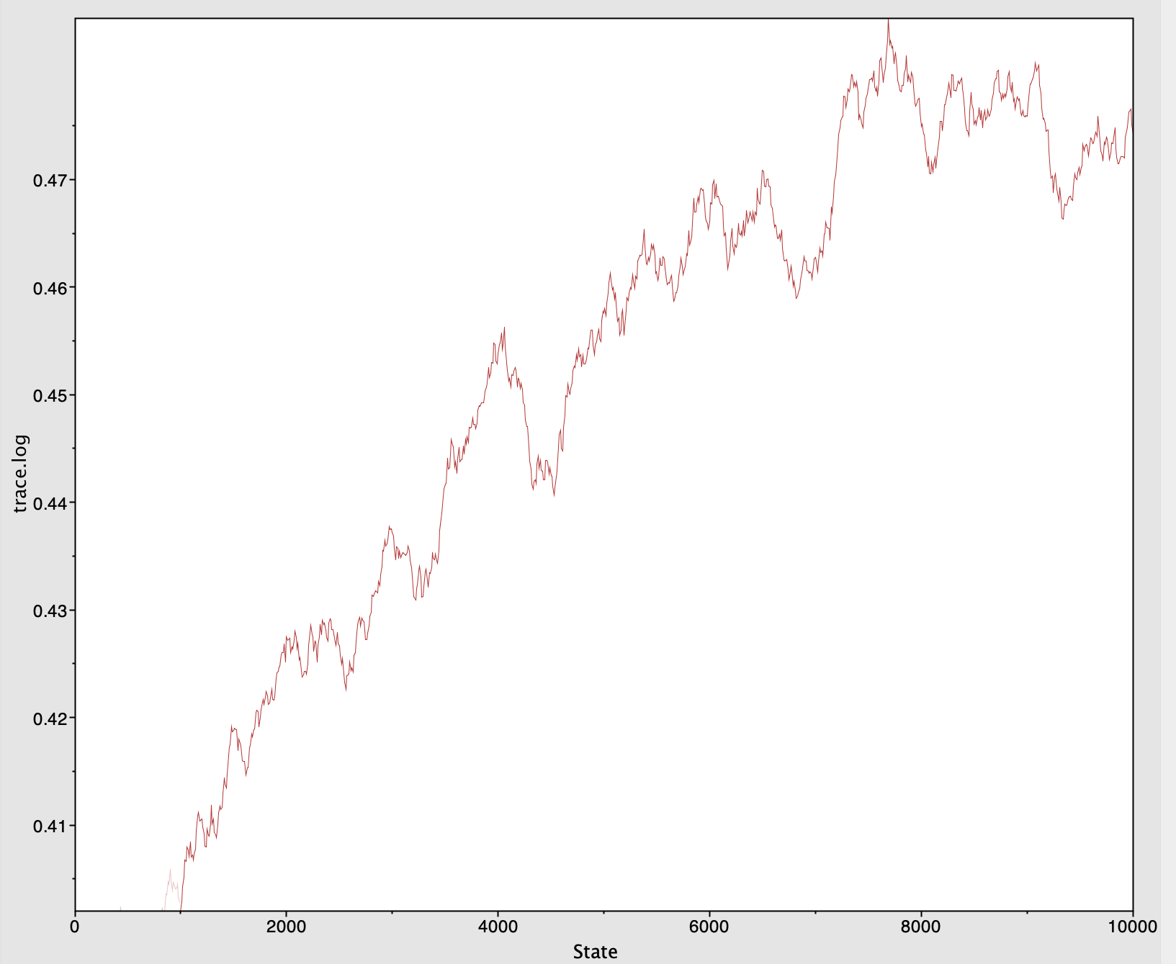
Problem case #1

Slide 9
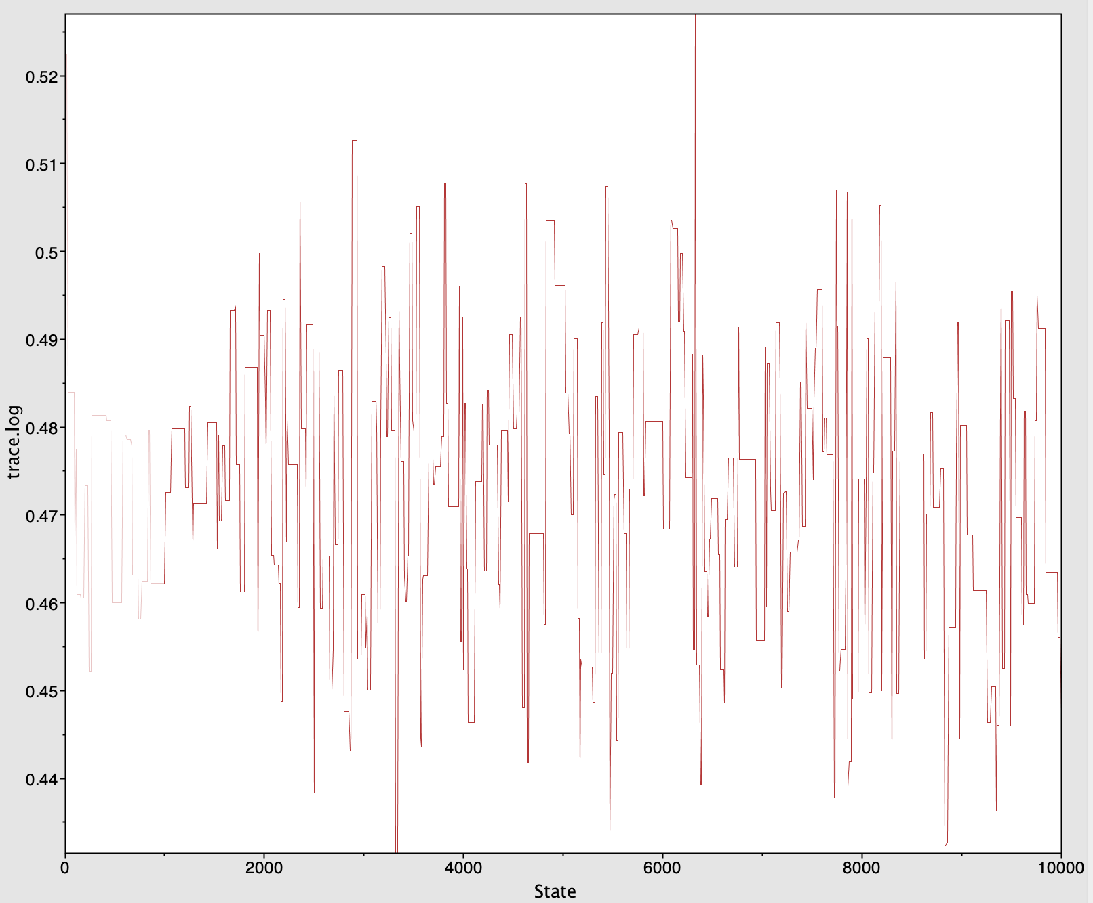
Problem case #2

Slide 10
What can you do ?
Increase sampling frequency
Adjust operator weights
Increase chain length
Check for model misspecification
Check for prior incompatibility
Simplify the analysis setup
Run heated chains (MCMCMC)
Talk to the developers / BEAST2 support group

Slide 11
Adjusting operator weights

Slide 12
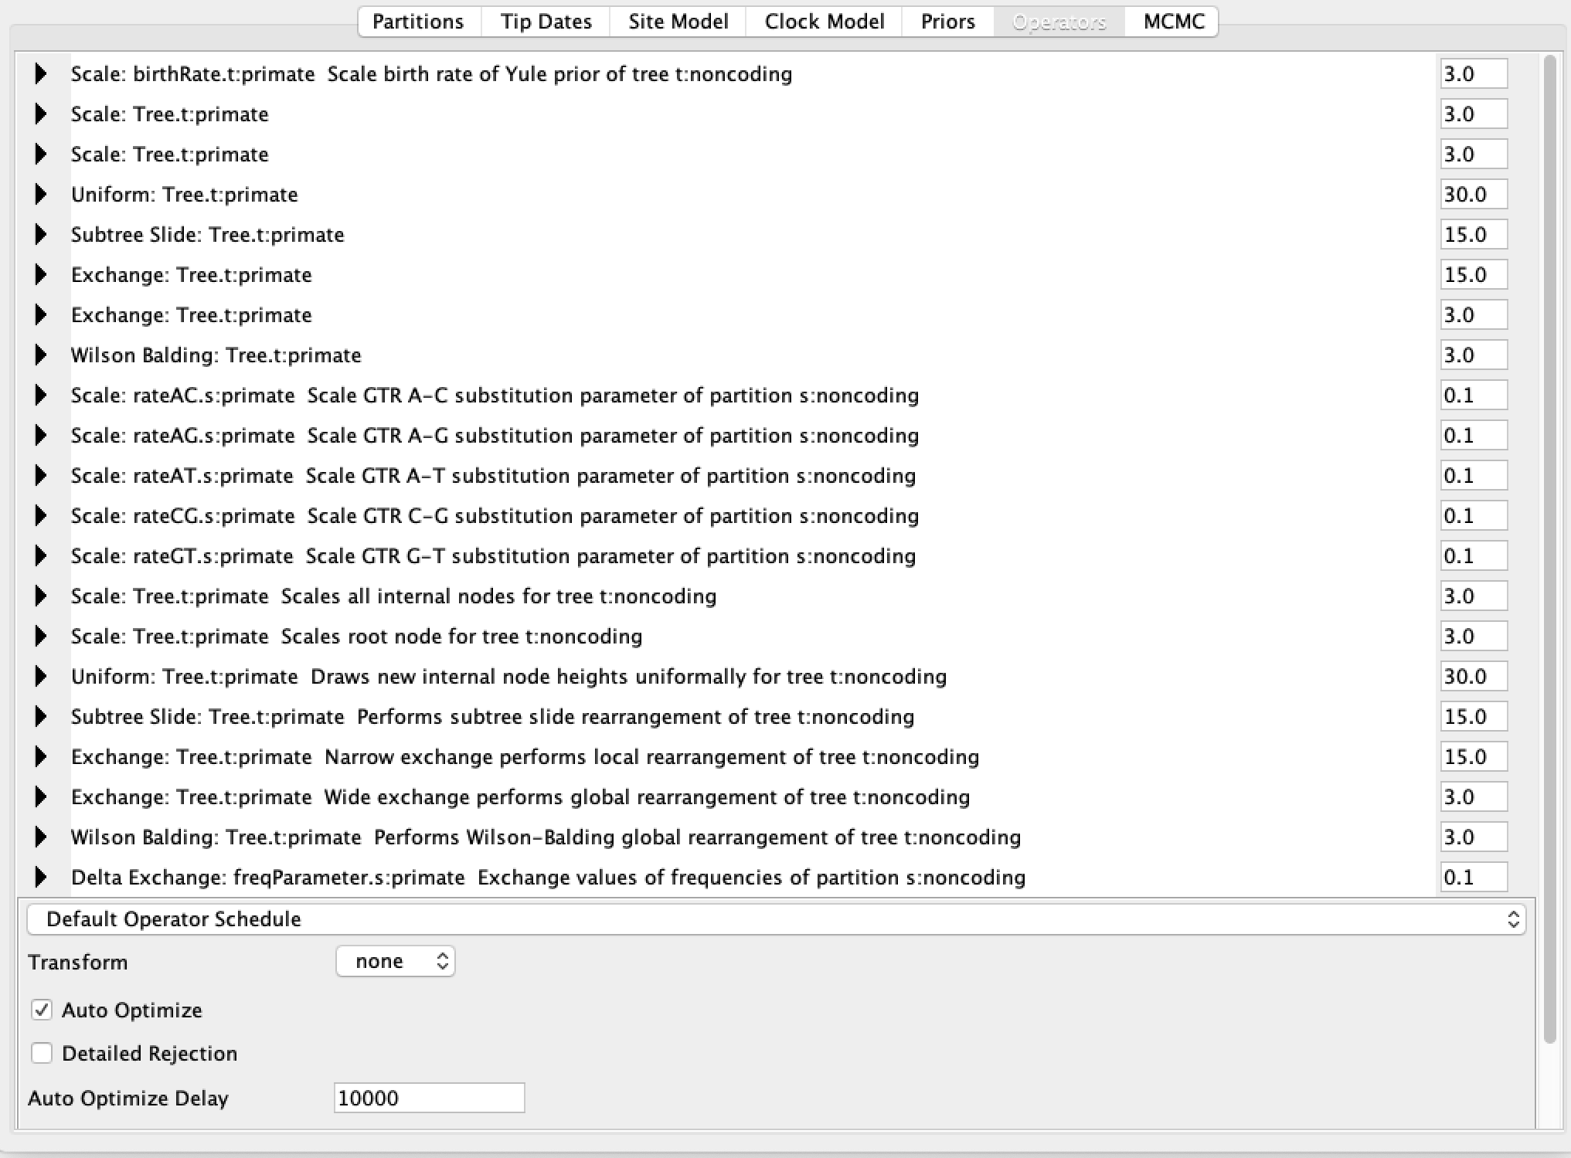
Adjusting operator weights

